Slide 1

Big Data in Retail and E-Commerce
Presented By :- SNEHAL TAWAR

Slide 2
Contents:
What is big data analytics?
Defining big data analytics in the e-commerce environment
Big data and their distinctive characteristics in the e-commerce environment
Business value of big data analytics for E-commerce firms
Conclusion

Slide 3
What is big data analytics?
Big data analytics is the use of advanced analytic techniques against very large, diverse big data sets that include structured, semi-structured and unstructured data, from different sources, and in different sizes from terabytes to zetabytes.
Three different ways of formatting data are commonly employed:
Unstructured = unorganized data (e.g. videos).
Semi-structured = the data is organized in a not fixed format (e.g. JSON).
Structured = the data is stored in a structured format (e.g. RDBMS).
Big Data is defined by three properties:
Volume = because of the large amount of data, storing data on a single machine is impossible. How can we process data across multiple machines assuring fault tolerance?
Variety = How can we deal with data coming from varied sources which have been formatted using different schemas?
Velocity = How can we quickly store and process new data?

Slide 4
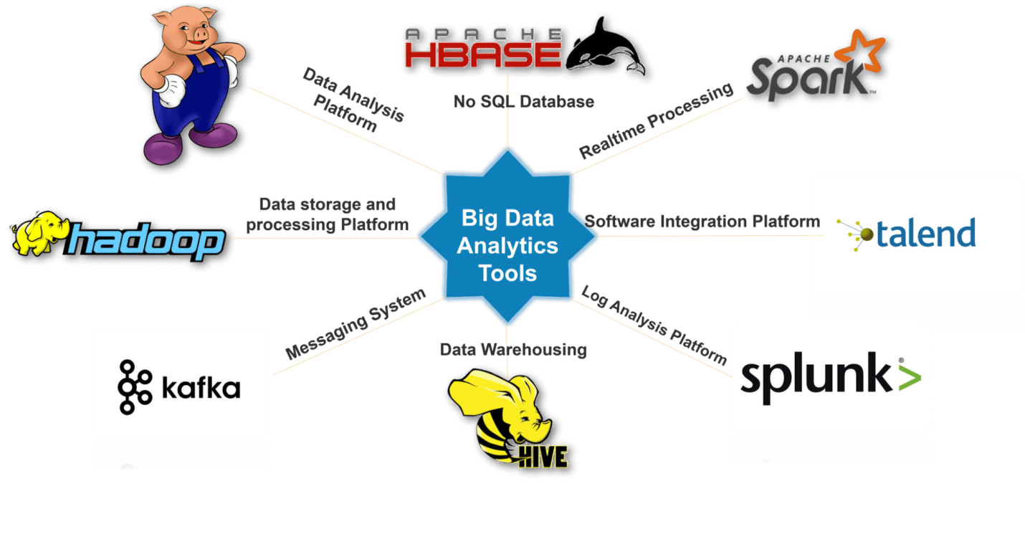
Big Data can be processed using different tools such as MapReduce, Spark, Hadoop, Pig, Hive, Cassandra and Kafka. Each of these different tools has its advantages and disadvantages which determines how companies might decide to employ them

Slide 5
Defining big data analytics in the e-commerce environment :
Big data in terms of five Vs: volume, velocity, variety, veracity, and value. The ‘volume’ refers to the quantities of big data, which is increasing exponentially. The ‘velocity’ is the speed of data collection, processing and analyzing in the real time. The ‘variety’ refers to the different types of data collected in big data environment. The ‘veracity’ represents the reliability of data sources. And, finally, the ‘value’ represents the transactional, strategic and informational benefits of big data. strategy-driven analytics has received much attention due to its role in better decision making.
Studies have also focused on “competitive advantages” and “differentiation”, while applying analytics to analyze real-time data. It is important to create an environment where big data, process optimization, frontline tools and people are well-aligned in order to achieve competitive advantages. It is evident that statistical, contextual, quantitative, predictive, cognitive, and other models are necessary prerequisites for big data analytics
“Big Data is Used to Spot the Next Big Trend”

Slide 6
Big data and their distinctive characteristics in the e-commerce environment:
Voluminous:
With the emergence of web technologies, there is an ever increasing growth in the amount of big data in the e-commerce environment. BDA takes a large volume of data that require a massive amount of storage and entail a large number of records. In fact, BDA encompasses large volumes of data (commonly expressed in petabytes and exabytes) that are used by decision makers for making strategic decisions.
Data collected in the big data environment are often unstructured and can incorporate video, image, or data generated from mobile technology. As such, it is unlikely that big data will be clean and free from any errors. While this poses an extra challenge for decision makers to get data ready for use, big data enable real-time decision making for e-commerce firms.
Variety:
The word ‘variety’ denotes the fact that big data originate from numerous sources which can be structured, semi-structured or unstructured. Variety is another critical attribute of big data as they are generated from a wide variety of sources and formats including text, web, tweet, audio, video, click-stream, log files, etc.
The analytic model used by e-commerce firms could comprise a variety of customer information, such as: customer profiles and historical data on buying behavior; regional and seasonal buying patterns; optimizing of supply chain operations; and, above all, the retrieval of any unstructured data from social media to predict buying by product, store, and advertising activities.

Slide 7
3. Velocity:
Velocity refers to the frequency of data generation and/or the frequency of data delivery. The term ‘velocity’ is the rate of change in big data and how quickly big data should be used in business decisions in order to add value.
In fact, given that greater data velocity is assured, data have the potential to open up new opportunities for organizations. , the high velocity of BDA can enable analysts to conduct consumer sentiment analysis and provide a clear picture about choices of brands and/or products.
4. Veracity:
Verification is necessary to generate authenticated and relevant data, and to have the capability to screen out bad data. Verification is essential in the data management process be-cause the existence of bad data might hinder management in making cognizant decisions. Likewise, bad data would have little relevance in adding business value.
Information technology (IT) units of e-businesses can play a key role in this regard by setting up an automatic verification system so that the big data used for business decisions have been authenticated and have passed through strict quality compliance procedures.
Types of big data used in E-commerce:
E-commerce firms ranging from Amazon to Netflix capture various types of data (e.g., orders, baskets, visits, users, referring links, keywords, catalogues browsing, social data), which can be broadly classified into four categories:
(a) Transaction or business activity data
(b) Click-stream data
(c) Video data and
(d) Voice data.

Slide 8
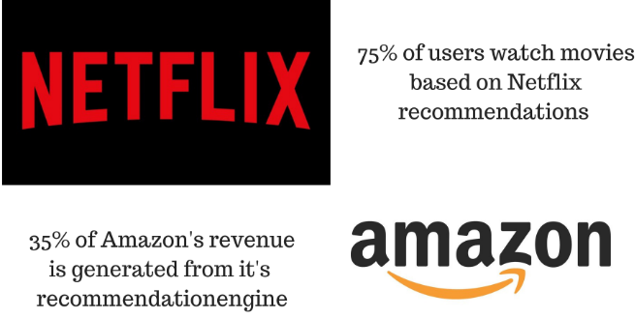
Business value of big data analytics for E-commerce firms:
1. Personalization:
Personalization can increase sales by 10 %or more and provide five to eight times the ROI on marketing expenditures. Bloomspot, in this regard, explored customer credit card data to track the spending records of the most loyal customers and to offer them rewards via follow-up offers and benefits which assisted in increasing customer loyalty.
Used to filter choices for particular user on the basis of their past searches or other customer’s search or purchase data. It gives users a personalized view on the eCommerce website and help them to select relevant products. Popular Recommendation Techniques:
Collaborative filtering
Content Based Filtering
Hybrid Recommendation Filtering

Slide 9
2. Dynamic pricing:
In today’s extremely competitive market environment, customers are considered ‘king’. Amazon.com’s dynamic pricing system monitors competing prices and alerts Amazon every 15 s, which has resulted in a 35 % increase in all sales. To offer competitive prices to customers on the eve of possible increases in sales (such as at Christmas or other festive times), Amazon processes big data by taking into account competitors’ pricing, product sales, actions of customers, and any regional or geographical preferences.
Big Data is Used to Spot the Next Big Trend
Crunching Numbers to Get the Right Products in Front of the Right Customers: The data is increasing with every single click on the internet. In order to make sense of this huge data and use it for company’s benefits etc, we need help from different Data Science techniques. The Challenge of In-Store Data Collection. With Location-based Advertising, Products Find the Customer
Timing is Everything … The Right Price at the Right Time: Opening the Valve on Data-Optimized Pricing
3. Supply chain visibility:
When customers place an order on an online platform, it is logical for them to expect that companies would provide the service of tracking the order while the goods are still in transit. Customers expect key information, such as the exact availability, current status, and location of their orders. E-commerce firms often face difficulty in addressing these expectations from customers as various third parties such as warehousing and transportation are involved in the supply chain process.

Slide 10

4. Customer service:
Another key area in which e-commerce firms can use big data is customer service. Customer grievances communicated by means of contact forms in online stores together with tweeting enable e-commerce firms to make customers feel valued when they call the service center resulting in prompt service delivery.
By offering proactive maintenance (i.e., taking preventive measures before a failure takes place or is even detected) using big data obtained from sensors rooted in products, e-commerce firms are able to offer innovative after-sales service.
5. Security and fraud detection:
Fraud is a billion-dollar business and it is increasing every year.
The PwC global economic crime survey of 2016 suggests that more than one in three (36%) of organizations experienced economic crime.
In addition, e-commerce firms are able to identify fraud in real time by combining transaction data with customers’ purchase history, weblogs, social feed, and geospatial location data from smartphone apps

Slide 11
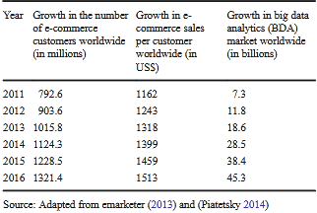
Predictive analytics:
Predictive analytics refers to the identification of events before they take place through the use of big data. Predictive analytics helps firms to prepare their revenue budgets. The preparation of these budgets assists e-commerce firms to recognize future sales patterns from past sales data (e.g., yearly or quarterly). This, in turn, helps firms to better forecast and determine inventory requirements, thus leading to the avoidance of product stock outs and lost customers.
Similarly, the application of a visualization and demand analytics tool at Netflix helped in the accurate prediction of consumer behavior and preferences when airing the “House of Cards” program in the United States (USA).

Slide 12
Conclusion
Big data analytics (BDA) has emerged as the new frontier of innovation and competition in the wide spectrum of the e-commerce landscape due to the challenges and opportunities created by the information revolution.
Big data analytics (BDA) increasingly provides value to e-commerce firms by using the dynamics of people, processes, and technologies to transform data into insights for robust decision making and solutions to business problems.
This is a holistic process which deals with data, sources, skills, and systems in order to create a competitive advantage. Leading e-commerce firms such as Google, Amazon, eBay, ASOS, Netflix and Facebook have already embraced BDA and experienced enormous growth.
Through its systematic review and creation of taxonomy of the key aspects of BDA, this study presents a useful starting point for the application of BDA in emerging e-commerce research. The study presents an approach for encapsulating all the best practices that build and shape BDA capabilities.
In addition, the study reflects that once BDA and its scope are well defined; distinctive characteristics and types of big data are well understood; and challenges are properly addressed, the BDA application will maximize business value through facilitating the pervasive usage and speedy delivery of insights across organizations.

Slide 13
References:
Big data analytics in E-commerce: a systematic review and agenda for future research. - Shahriar Akter & Samuel Fosso Wamba
https://towardsdatascience.com/5-data-science-project-every-e-commerce-company-should-do-8746c5ab4604
https://analyticsindiamag.com/10-data-science-projects-most-e-commerce-businesses-are-using-in-india/
https://www.datasciencegraduateprograms.com/retail/
https://www.greatlearning.in/blog/applications-of-data-science-in-e-commerce-industry/
https://www.wikipedia.com/

Slide 14
THANK YOU !

